Slide 1
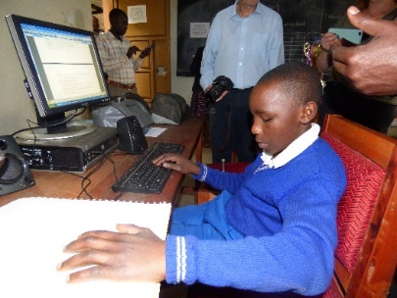
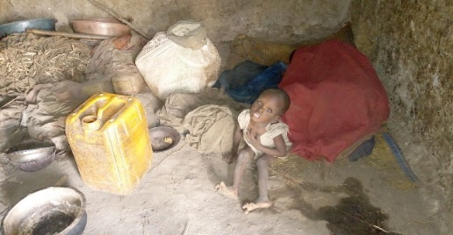
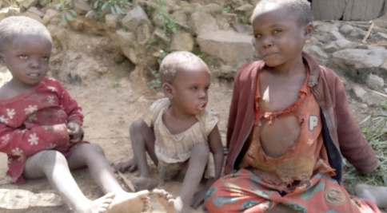
Page 1
December 2019
Newsletter 12
Supporting the Education of Disadvantaged Children in Uganda
Welcome to SEDCU Newsletter No.12 covering the period July 2019 – December 2019
The highlight of 2019 was our return to Uganda! Four trustees participated in the visit this time, and as always we covered our own travel and accommodation costs. For our two younger trustees this was their first visit to Uganda, and they share their impressions later in this newsletter. We went with an ambitious agenda, and we are delighted to report we were able to tick every box. We visited all 30 sponsored children at 7 places of education scattered across the country and discussed progress, wellbeing and future aspirations with each child and relevant teachers. We were also able to visit some of the homes to meet with family members. In addition, we reviewed progress of all the projects funded by SEDCU and were very satisfied with what we found.
None of this would have been possible without the commitments of our key contacts in Uganda and the teachers, all of whom gave generously of their time. As ever, everyone that we met gave us a genuinely warm welcome and impressed us with their frank and open approach.
SPONSORS URGENTLY SOUGHT!
We have just been informed about a tragic situation by our key contact in Kisoro (formerly Head at KDS before his promotion). This is what he wrote:
“(I am writing to you about) a family that I came into contact that is extremely poor. The father of the 3 kids is helpless, the mother of the kids is mentally sick and at the same time blind, 2 of the kids are visually impaired with severe jiggers. I would be the happiest if you look at such a family and God willingly you share the experience with some other sympathisers and we see if can do something to (help) one or 2 children in this family. I know you are strained but in case am opportunity arises am submitting to you that request. In the first photograph you see is the mother of the children wrapping herself in a red cloth. She spends all her time where you see her. That is even where she sleeps. Imagine that child with 3 years spending all her lifetime from birth to the current age sleeping in such an environment. The next photo is of her three children”
The SEDCU trustees hope to be able to find a sponsor for one of these children - could you help?
One of the blind children at KDS, who has been sponsored by the staff of an organisation for a number of years, now needs a new sponsor. W is 15 years old and has just taken his P7 Leaving Certificate exams at Kisoro Demonstration School (KDS). He is very hard working and has generally been near the top of his class. He particularly enjoys Music, English and Social Science. He is also good at IT. He is well behaved and sociable and has the potential to go onto a specialised Secondary School if he is successful. However, like all blind children he faces some many challenges. W is pictured in the KDS section of this newsletter playing the trumpet. If, as anticipated, he does well in his exams, he should go on to one of the few secondary schools which cater for blind children next February. Could you help to make this possible?

Slide 2
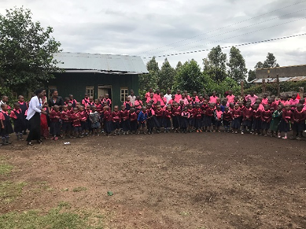
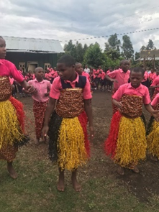
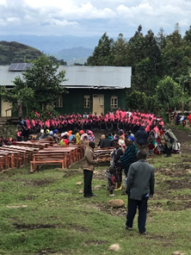
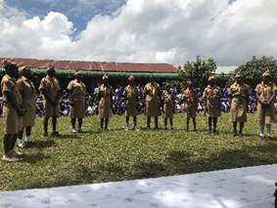
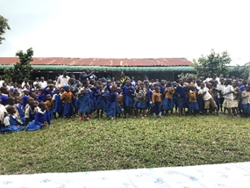
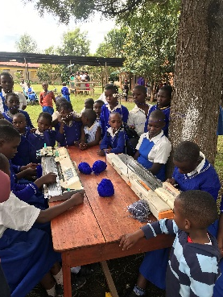
Page 2
December 2019
Newsletter 12
SEDCU 2019 VISIT – Trustees Becky and Kate reflect on their first visit to Uganda
When asked if we wanted to visit Uganda we experienced a mixture of emotions, excitement and apprehension. Here was an opportunity to see and meet the children, schools and staff which SEDCU and its supporters work so hard to support.
From the moment we landed, we were welcomed warmly and this continued throughout our trip. A beautiful country full of rich green landscapes and cultivation, mountains and rainforests, yet so poor in so many other ways!
Both Mgahinga Community Junior School and Kisoro Demonstration School received us with the most magnificent of welcomes. At MCJS we met with Festo, Emmanuel, Philip, Patricia, Margaret and the acting head teacher, George, all working for and advocates of MCJS. They were so friendly and happy to meet us. For us it was lovely to put faces to names. We met the local school council and they held a meeting in which leaders of the local communities spoke and parents introduced themselves, shared SEDCU views and ambitions and gave their thanks to SEDCU. At KDS we met with Head Teacher Stephen and Deputy Head Teacher Joseph and were joined by Gerald, the previous Head Teacher. At both schools the children and teachers put on a performance; MCJS was full of singing, dance and acting and at KDS a brass band, poetry and songs led by both deaf and blind children brought alive for us how the children live by their motto of ‘Disability is not Inability’.
Above – Mgahinga Community Junior School
Above – Kisoro Demonstration School
It was overwhelming to hear just how much SEDCU is doing to make a difference and we were impressed to see all of the great work the staff do to support and educate the children and make their lives better.

Slide 3
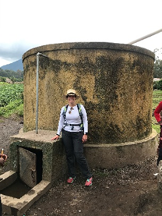
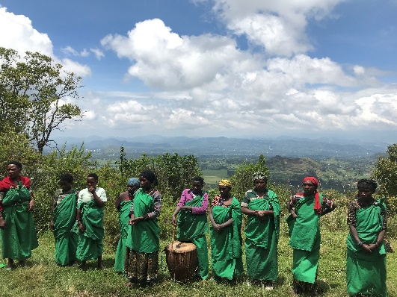
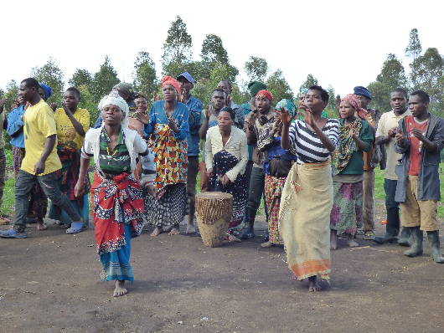
Page 3
December 2019
Newsletter 12
On our tour of MCJS, we were able to see the water tank, which had
enabled the school and village to survive a drought without having
to buy water. We also saw the progress of the new kitchen and dining
hall. The roof was being built during our visit and you could see how
this new structure was going to support the school and the community.
To be able to visit all 30 children during out time in Uganda was the most wonderful thing. To speak to them and understand their individual progress was important to us. But, even more important, was to also understand how each child feels happy and safe. When you witness the poverty of people and children at first hand, whilst this is distressing and you feel the need to help all, it was rewarding to see how the support of SEDCU is helping specific children and the schools.
We met with the Nursery Classes at MCJS and spoke with each of the children. It was wonderful to hear how happy they are at school and their ambitions for their own futures.
We both met with our own sponsored children at both schools, which was wonderful, rewarding for us and for them. It was so positive to hear that they are progressing well at school and most importantly for us, happy and safe.
We were lucky enough to walk the 6 hour Batwa trail, led by four Batwa men showing us the traditions of living in the Mgahinga rainforest and sharing their survival tactics. They shared the history of the Batwa tribe and how they worked with other tribes to survive. We also visited the Batwa King’s cave where we were met by the Batwa community. They put on the most wonderful dance on the side of Mt. Gahinga, a dormant/extinct volcano in the Virunga Mountains on the border between Uganda and Rwanda. We also visited a local Batwa village, which has been recently constructed on land made available by the owner of a local tourist lodge. Here they welcomed us with a traditional Batwa dance which Ben and Kate joined in with – how embarrassing! Whilst it was good that they had this space, they still require further housing for the community and land to farm to be able to feed their families.
Batwa Trail Dance Batwa Community Dance
There were many heart-breaking and humbling moments during our journey through Uganda but seeing the children so full of joy and happiness made it all worthwhile.
Whilst so much has been achieved at both schools, it is evident there is so much more to do. 2020 will be a year of fundraising for various projects at the schools
There is an ongoing need to support more children through sponsorship. We met our existing sponsored children who need further support, some of their siblings, and we were introduced to new families who have children that require support to meet their potential in life. We may not be able to change the world for everyone, but we can change the world for someone.

Slide 4
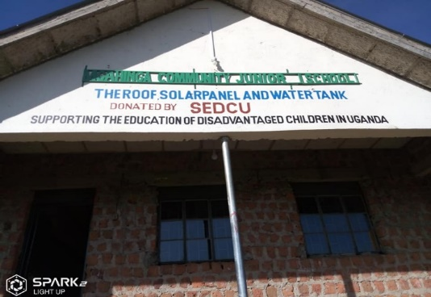
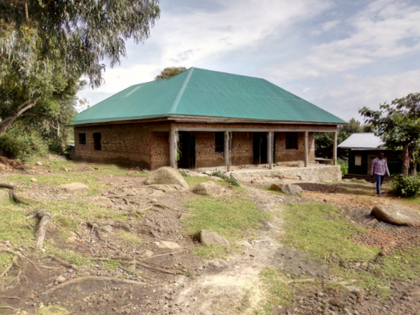
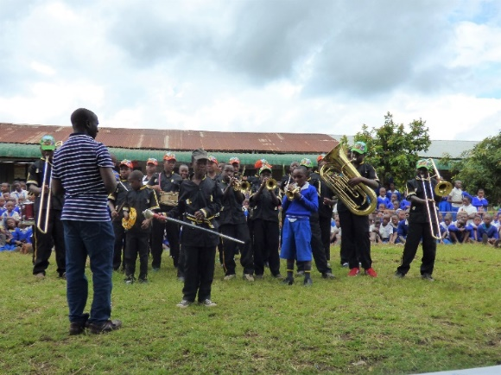
Page 4
December 2019
Newsletter 12
MGAHINGA COMMUNITY JUNIOR SCHOOL (MCJS)
This was the first time we had visited the school since the demolition of the old mud construction potato store where the school began with just three damp, dark classrooms. The site has now been given over to the construction of a new Kitchen and Dining Hall for which SEDCU has donated £4260, a significant fraction of the total cost. We were delighted to find the construction well advanced and, indeed, within 2 weeks of our departure the roof was on thanks to donation from a Swedish charity.
The next significant building project will be the creation of a new sanitary block as mentioned in the last newsletter. While we were there, we were able to discuss the siting and design. This has been refined to incorporate a bio energy septic tank, and following our visit we sent £2000 so the work could get underway. Our thanks go to the Rotary Club of Welshpool and District as well as to a private donor which made this possible. We will need to raise a further £1600 to complete the job in due course. We have also recognised the continuing need for more solar power and have sent a further £800 to add a second panel on the roof of the new classroom block.
Arriving at MCJS on the first morning of our latest visit, we were greeted by many smiling faces. The children’s joy at being at school was evident. The school has continued to grow and there are now 160 children on roll. This growth must in part be due to the high academic standards being achieved by the school and its staff. Seeing the new classroom block in use was gratifying – SEDCU made a major contribution to this construction project and another charity, School Places, supported us in this.
We were able to sit in on part of a lesson in each class and the children were happy to show us their work. We currently sponsor 13 children at the school, three of whom have just taken their P7 Leaving Exams and will be eagerly awaiting their results. They all told us they are hoping to continue their education at secondary level – we wish them luck!
KISORO DEMONSTRATION SCHOOL (KDS)
Since our last visit, there been a significant growth of 27% in the number of children with disabilities attending KDS. The charity Sustain for Life (SfL) has funded renovation of several buildings and is now constructing a new dormitory block for deaf pupils. We have been asked to consider supporting one other exceptionally needy child.
As is traditional, we were treated to a musical performance. In the past, SEDCU has donated a number of musical instruments and amplification equipment, and we were delighted to see instruments being played by disabled as well as able-bodied children. To see the blind and deaf dancing and singing was truly humbling. We were told how important the jazz band had become for the school.
This photo shows the Band being led by W, a sponsored blind boy who is playing the trumpet solo

Slide 5
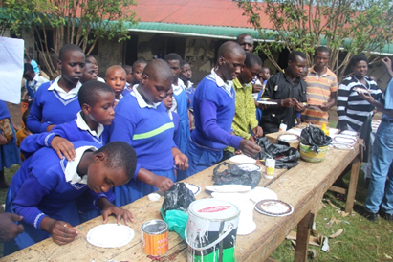
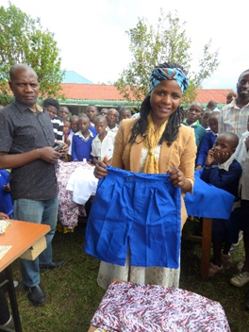
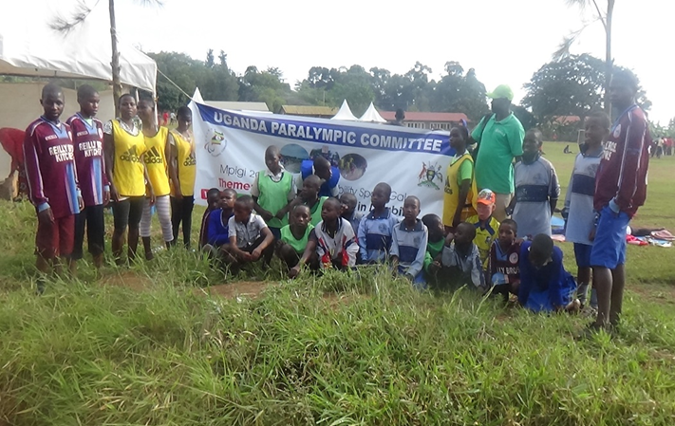
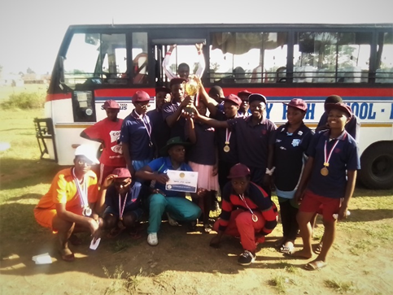
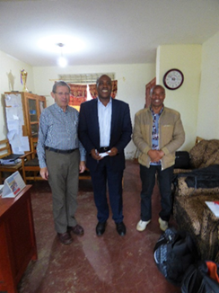
Page 5
December 2019
Newsletter 12
The Arts and Crafts project has continued to flourish, the children are constantly learning new skills, and getting real satisfaction from being able to produce knitwear, plaques and bags.
Some of you may recall the deaf girl E who graduated from vocational college last year. This year she has returned to KDS where she has been developing her design skills, sewing school uniforms and helping other children to knit school sweaters.
For the 4th year, SEDCU has provided funds (just over £1000) to enable the KDS special needs children to participate in the National Sports Gala organised by the Ugandan Paralympic Committee at Mpigi. A total of 28 children participated (including those sponsored by SEDCU and SfL) and they were accompanied by three teachers and five volunteer guides. The participants were in three categories: blind (8), low vision (5), deaf (10), they participated in a number of track and field events, and the team came top overall – a wonderful achievement, well done!
For the 5th year, SEDCU provided the required funding (about £1100) to enable KDS to send a scout troop of 13 children to participate in the Uganda National Scouting Competition in Kampala which has specific classes for deaf and for blind scouts. They did extremely well with both the blind and deaf teams coming first in their classes out of ten districts that participated. We thank the Rotary Club of Hexham for making this possible. As a result, the troop were invited to represent Uganda in the East African Competition to be held in South Sudan, which was subsequently moved to Rwanda. However, the SEDCU trustees have reluctantly decided not to fund this as the cost was disproportionate and beyond our resources. Also we felt that such a large sum would be better spent on other ways to benefit many more children. Another factor was the current poor relations between Uganda and Rwanda which had forced the border to be closed normal traffic, possibly putting the competitors in doubt.
HORNBY HIGH SCHOOL
SEDCU currently supports one blind girl who attends Hornby High at secondary level and has just taken her ‘O’ level exams. The school approached SEDCU about funding for a team of 20 blind and partially sighted children, supported by 3 teachers, to participate in a National Disability Sports Gala for older children to be organised by the Ugandan Paralympic Committee (UPC) in Mpigi. These games were to be used by the UPC to select athletes to be invited to participate in the African Paralympic Games Qualifiers in Morocco in January 2020, and thereafter the Tokyo Paralympic Games in August 2020 (these later stages to be funded by the Government).
KISORO VISION SECONDARY SCHOOL (KVSS)
We are pleased to report that 3 children are now being sponsored through SEDCU to attend KVSS. This is a large and growing private secondary school with about 1200 pupils. KVSS in 2020, always depending on their results in the Leaving Certificate exam. It is developing an excellent reputation, and it is hoped that further children from the MCJS P7 class will be able to attend KVSS , always depending on their Leaving Certificate exam results.
The photo shows Ben with the Head Teacher in the middle and our MCDO contact and friend to SEDCU on the right.

Slide 6
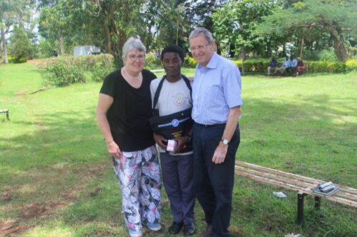
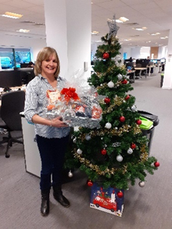
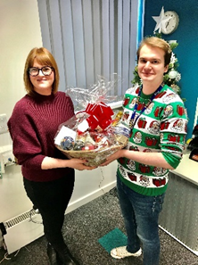
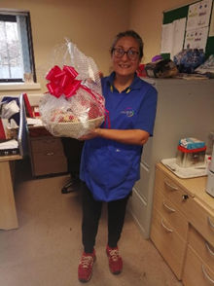
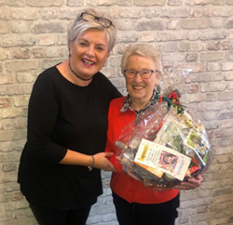
Page 6
December 2019
Newsletter 12
IGANGA HIGH SCHOOL
One of the blind children, G, sponsored through SEDCU for seven years, took his ‘O’ level exams at Hornby High School and decided he would move to Iganga to study for his ‘A’ levels. This is a girl’s school with a mixed unit for blind children. He has just taken his exams. We paid G a visit and found that he was doing well. Both he and his teacher are optimistic about his prospects of going to University next year, either to study Law or English, in the latter case with a view of training as a teacher in due course.
FUNDRAISING
It looks as though 2019 will prove to have been a very positive year for SEDCU with a significant growth in income thanks to the generosity of our donors. However, this has been more than matched by increasing demands on our resources to meet the needs of the children and schools, and we will need to do all we can to at least maintain our level of income next year.
This year we were particularly grateful to our trustee Kate Coulson who took part in a triathlon in the Cotswolds which included a 1.2 mile swim, a 56 mile cycle and then a 13 mile half marathon – 70.2 miles in all! She raised well over her £1000 target from her many sponsors, and this has been allocated to the Bursary Fund to meet the more costly needs of the older children. Our website explains how we will operate this Fund.
We are delighted to report that Hexham Inner Wheel has nominated SEDCU as its international charity of the year, and they have already made an initial donation following a presentation about SEDCU at one of their meetings.
We are also pleased to have created 5 Christmas hampers with an African theme, and people have been invited to pay for a numbered square in a 50 or 100 grid, the winning square ‘owner’ being awarded the hamper. Four of the five are pictured here. This has raised over £500.
Could you help with our fundraising? Could you perhaps run a coffee morning, an afternoon tea, wine tasting, or a barbeque (when the weather warms up!)? Could you run a raffle or your own 100 squares hamper lottery? Whatever you would like to do, the SEDCU trustees will be able to give you support. If you would like to run a lunch or evening meal in aid of SEDCU, one of us will be delighted to tell the SEDCU story and illustrate this with some amazing slides, just give us the word and we will be there!
Thank you to our sponsors, donors, supporters and all who take an interest in SEDCU. Together we can continue to make our stated mission a reality. If you wish to donate you can do so through the website or by cheque made out to SEDCU and mailed to Lowstead, Highford Lane, Hexham NE46 2DP. Or you can pay online into the SEDCU account, sort code 20-74-81, account number 83561356.
Email us at info@sedcu.org.uk Visit us at www.sedcu.org.uk

